Slide 1






Your Voice Matters. Don’t Let AI Drown It Out
Checkpoint 3
Ângela Ribeiro (109061)
João Santos (110555)
João Viegas (113144)
Hugo Castro (113889)
Ana Rita Silva (114220)
Advisors:
Prof. João Rafael Almeida
Vicente Barros
Notes:
ugo
2ª Milestone
Elaboration Phase
BotBlocker

Slide 2

PROJECT OVERVIEW
BotBlocker is a browser extension and website that uses community intelligence to identify and block automated social media profiles.
2

Slide 3

TABLE OF CONTENTS
01
Previously Implemented Functionalities
02
Newly Implemented Functionalities
03
Project Calendar
3
Notes:
ugo

Slide 4

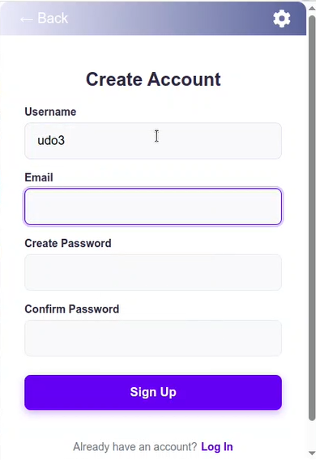
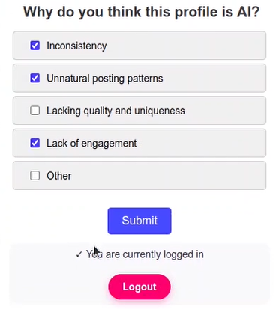
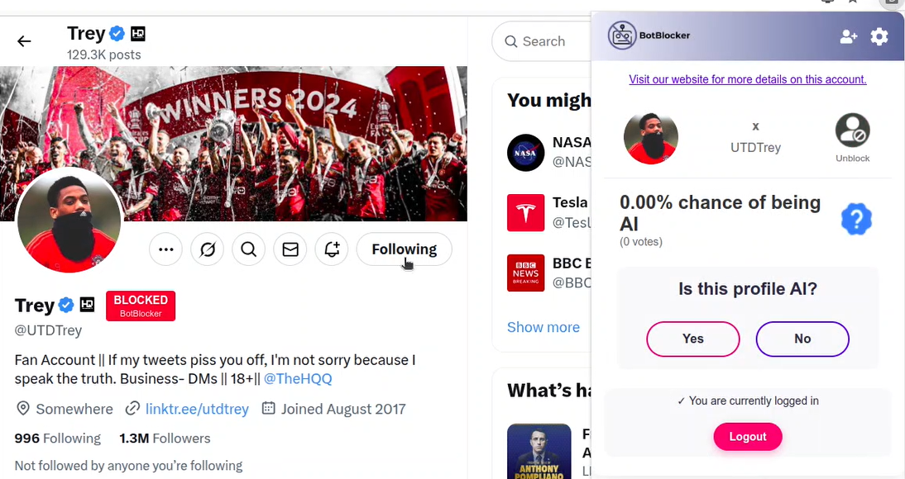
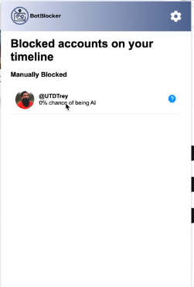

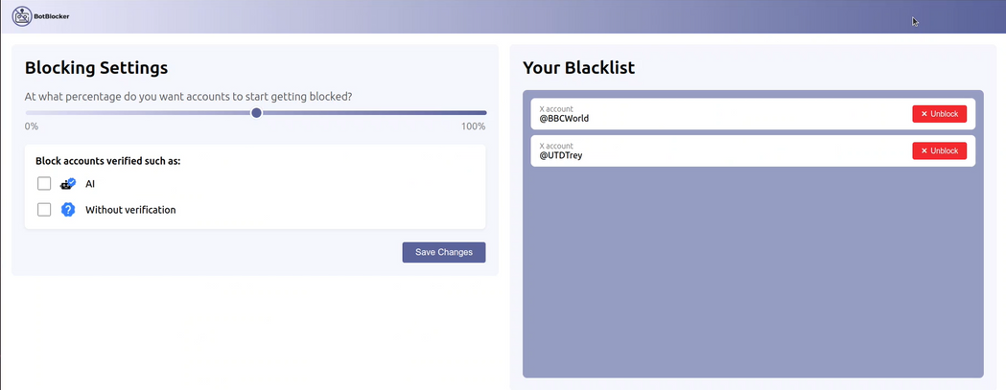
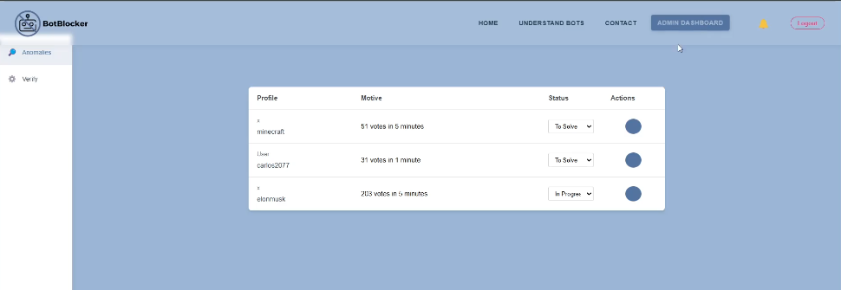
PREVIOUSLY IMPLEMENTED FUNCTIONALITIES
4
Notes:
ugo
administrador e verifier
1. alterar roles, suspender contas ou banir utilizadores
2. logs de atividades suspeitas (spam voting)
3. moderar avaliações feitas pela comunidade
4. selos de "Bot" ou "Humano" (transparência)

Slide 5
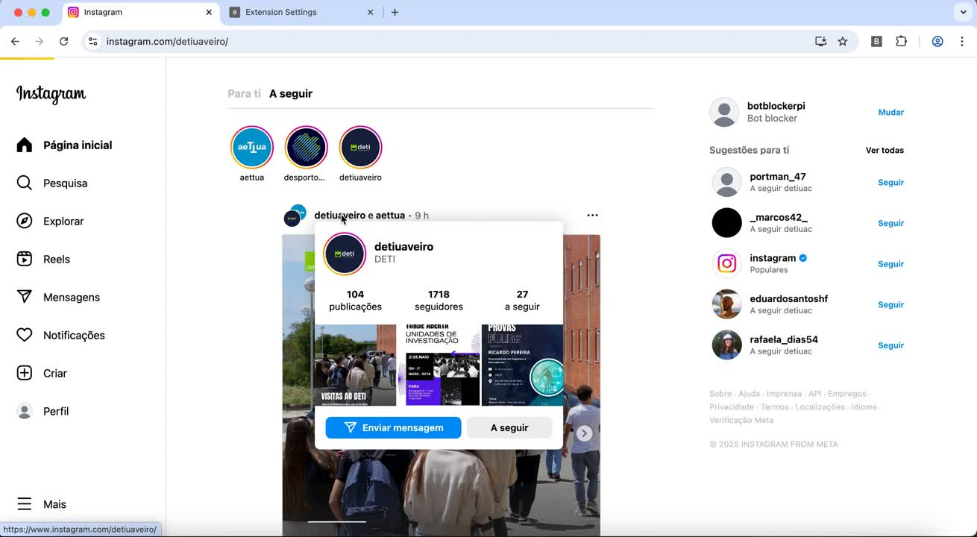
NEWLY IMPLEMENTED FUNCTIONALITIES
Video demo - Full Instagram Implementation + Blur/Remove Feature
5
Notes:
ugo
administrador e verifier
1. alterar roles, suspender contas ou banir utilizadores
2. logs de atividades suspeitas (spam voting)
3. moderar avaliações feitas pela comunidade
4. selos de "Bot" ou "Humano" (transparência)

Slide 6
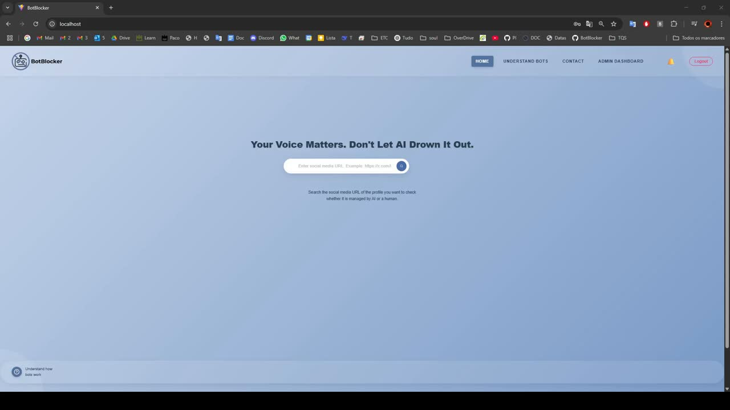
NEWLY IMPLEMENTED FUNCTIONALITIES
Video demo - Admin Full Anomalies Dashboard
6
Notes:
ugo
administrador e verifier
1. alterar roles, suspender contas ou banir utilizadores
2. logs de atividades suspeitas (spam voting)
3. moderar avaliações feitas pela comunidade
4. selos de "Bot" ou "Humano" (transparência)

Slide 7

PROJECT CALENDAR
10/02 - 17/02
18/02 - 24/02
25/02 - 03/03
04/03 – 10/03
Project Foundation & Documentation Setup
Use Case Diagram (JC, JV, Â)
GitHub Repository Organization (H)
Setup Documentation Website (AR, H)
Project Planning and Framework
Project Calendar Creation (*)
Jira Project Setup (Â)
Project Presentation Preparation (*)
Definition of Context and State of the Art (JV)
High-Level Architecture Design (JC)
Requirements & UX Design
Requirement Gathering (*)
Functional Requirements (JV)
Non-Functional Requirements (Â)
Define Personas and Scenarios (JC)
Develop the mockups (AR, H)
System Modeling
Refine the state of the art (JV)
Technological Model (*)
Define the Domain Model (JC)
Make the Deployment Diagram (JC)
Presentation (*)
11/03 – 17/03
18/03 – 24/03
25/03 – 31/03
Extension Initiation and Database Setup
Dockerize the project (H)
Database Configuration and Setup (Â, JC)
Extension Initialization and Configuration (Â, JC)
Development of Extension Popup Frontend (AR)
Backend API Implementation for Popup Interaction (JV)
Interface Development & API Integration
Development of the extension interface and the user website (JC, H)
Develop the frontend for the verifier interfaces (AR)
Continue Implementation of RESTful API (JV, Â)
Blocking & Filtering System Development
Develop the block system (JC, H, JV)
Develop the filtering / blacklist management (AR, Â)
7
Notes:
ângela

Slide 8
PROJECT CALENDAR
01/04 – 07/04
08/04 – 14/04
15/04 – 21/04
22/04 – 05/05
Presentation and refinement
Presentation (*)
Continue developing the block and blacklist management system
Finalize the block and blacklist management
Admin Interface & API Enhancement
Develop the frontend of the admin interface
Continue Implementation of RESTful API
06/05 – 19/05
20/05 – 26/05
27/05 – 02/06
Improving upon the filtering techniques
Demo + poster for students@deti & video
Poster
Video
Demo
Finish technical report (*)
Final presentation
Work on presentation (*)
8
Notes:
ângela

Slide 9
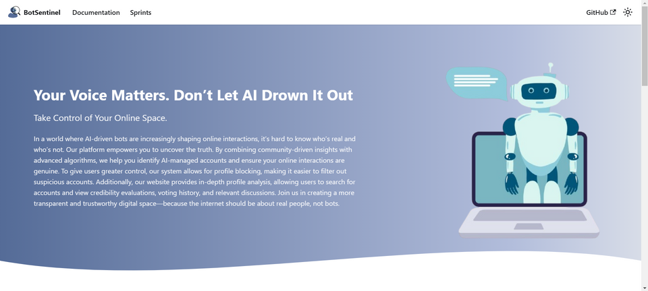


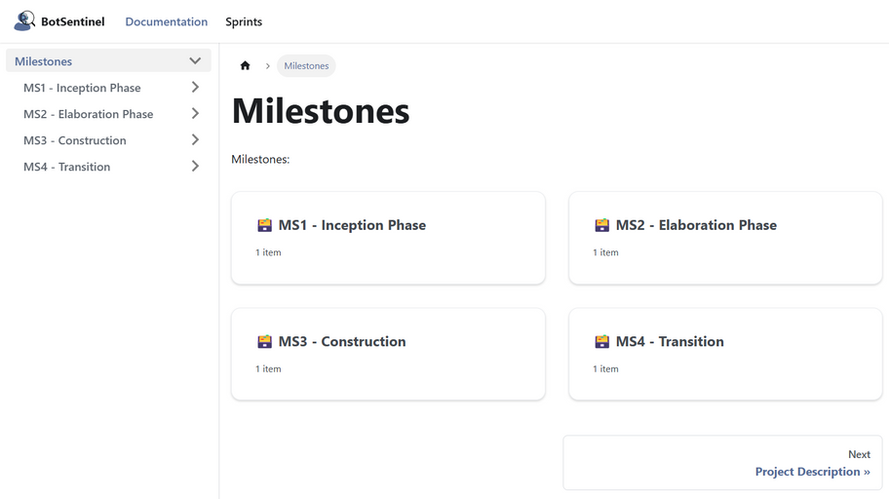
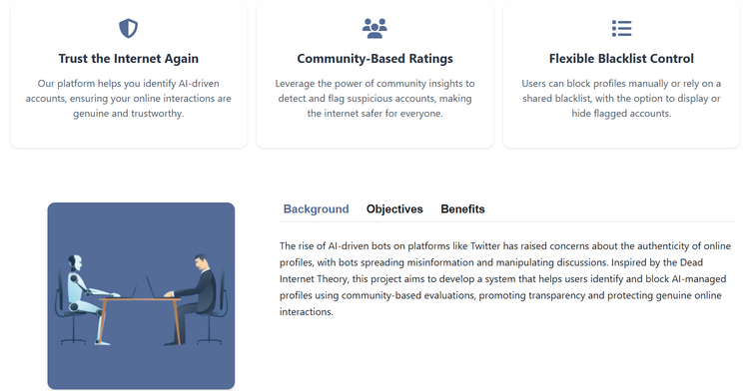
Thank you!
https://botblocker-pi.github.io/Documentation/
9
Notes:
ângela

Slide 10
